Slide 1

Machine Learning
DSBA 6190-U91 | Colby T. Ford, Ph.D.

Slide 2
Overview
Intro to Machine Learning
Machine Learning in the Cloud
Cognitive Services
Basics of Algorithms
Regression
Classification
Clustering
Scaling Up with Parallelization
Training
Cross-Validation
Parameter Tuning

Slide 3

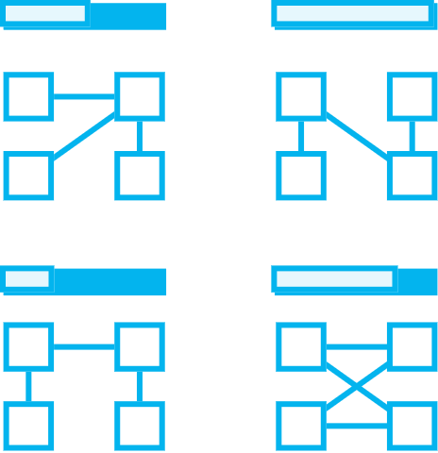


Intro to Machine Learning
Prepare Data
Build & Train
Deploy
Connect to various sources to ingest data
Train with the data to establish a model
Deploy the model and track performance

Slide 4
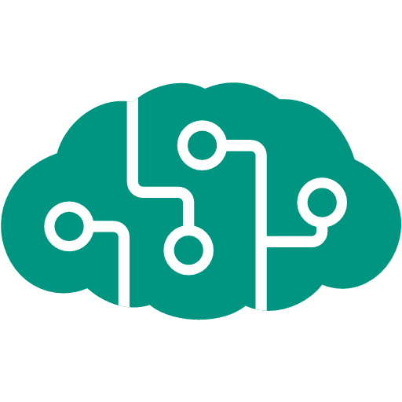
Machine Learning Options in the Cloud
Databricks
Machine Learning Studio
Machine Learning Services
DSVM
Me, too!

Slide 5
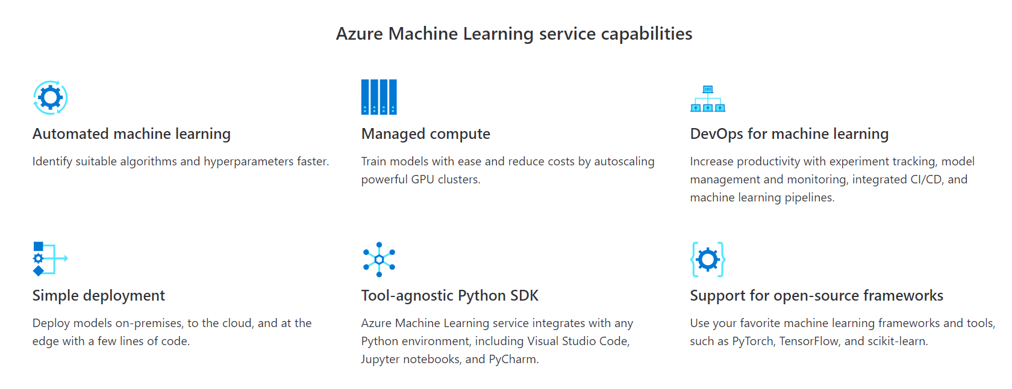
Azure Machine Learning Services
Simplify and accelerate the building, training, and deployment of your machine learning models. Use automated machine learning to identify suitable algorithms and tune hyperparameters faster. Improve productivity and reduce costs with autoscaling compute and DevOps for machine learning. Seamlessly deploy to the cloud and the edge with one click.
https://azure.microsoft.com/en-us/services/machine-learning-service/

Slide 6
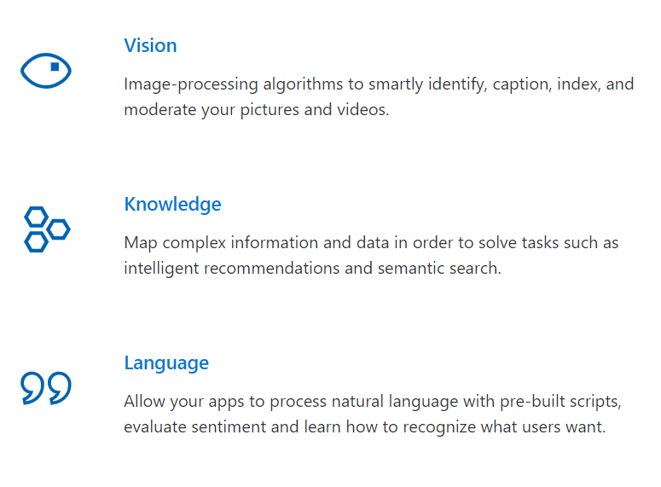
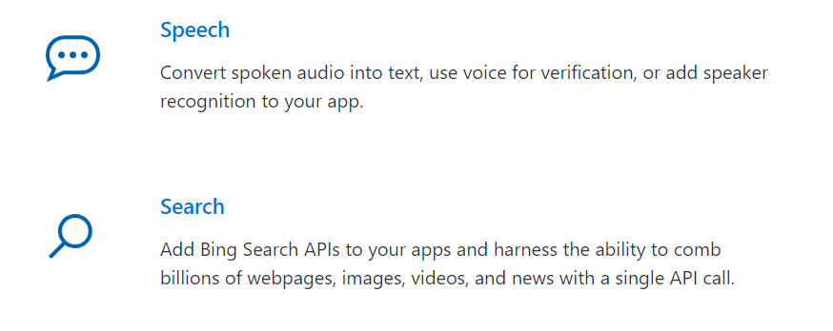
Microsoft Cognitive Services
Infuse your apps, websites and bots with intelligent algorithms to see, hear, speak, understand and interpret your user needs through natural methods of communication.
https://azure.microsoft.com/en-us/services/cognitive-services/

Slide 7
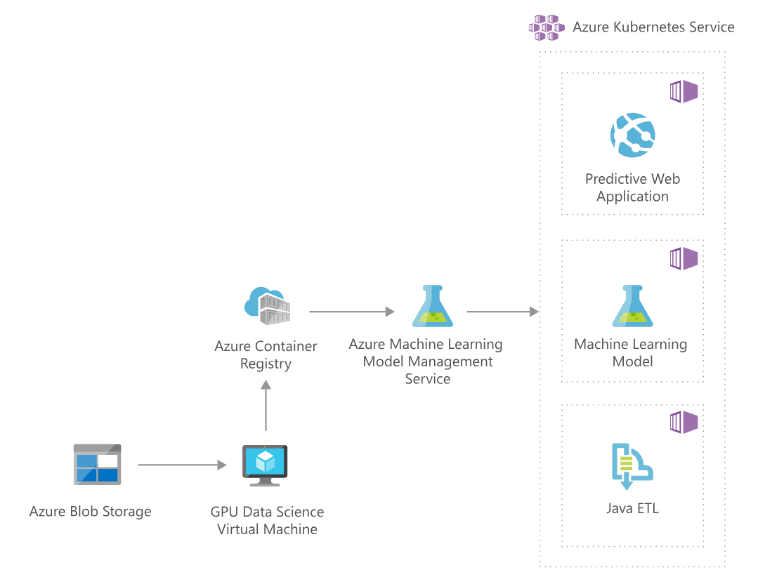
https://azure.microsoft.com/en-us/solutions/architecture/image-classification-with-convolutional-neural-networks/

Slide 8
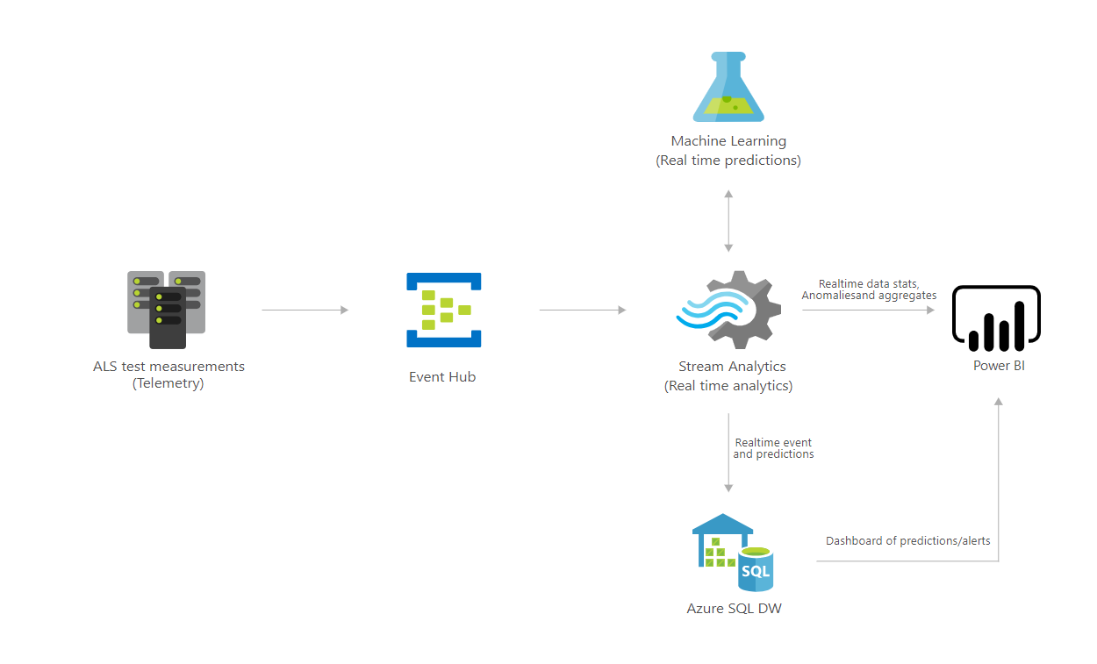
https://azure.microsoft.com/en-us/solutions/architecture/defect-prevention-with-predictive-maintenance/

Slide 9
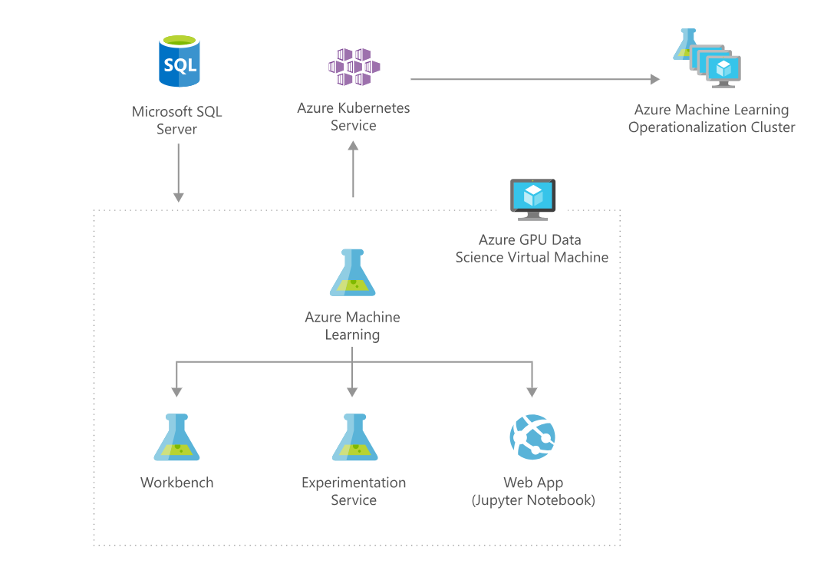
https://azure.microsoft.com/en-us/solutions/architecture/information-discovery-with-deep-learning-and-nlp/

